Slide 1
Titrations
Analytical Chemistry!!
Titration requirements:
Quantitative chemical reaction
A measureable change at the equivalence point (visual?)
Perhaps a measureable quantity during the entire reaction
Commonly using a burette
Sometimes the titrant is generated in situ
Usually electrochemically
An experienced student with a burette and visual indicator can achieve <0.2% precision and accuracy
Slide 1

Slide 2
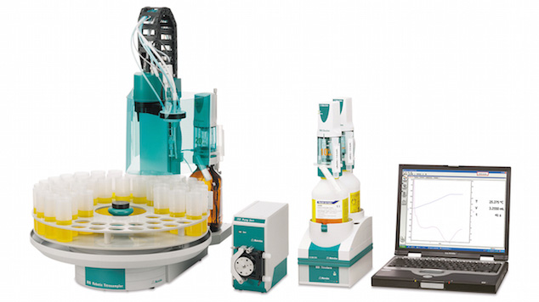
If You’re Working in a Lab
with Enough Money ……..
Computer controlled syringe adds the titrant
Requires a continuously monitoring sensor technology
https://www.metrohm.com/en-gb/products-overview/titration/titrotherm/titrotherm-automation/
Slide 2

Slide 3
Back to General Chemistry
General Classes of Titrations:
Acid/base
Precipitation
Redox (oxidation/reduction)
Complexation (ligands or chelating agents)
Did everyone run an acid/base titration in gen chem lab?
Let’s review weak acid chemistry:
HA + H₂O H₃O⁺ + A⁻
K_{c} = [A⁻][H₃O⁺]
[HA][H₂O]
K_{a} = [A⁻][H₃O⁺]
[HA]
Slide 3

Slide 4
Let’s Follow Where the Math Leads
K_{a} = [A⁻][H₃O⁺]
[HA]
pH = -log([H₃O⁺])
log(K_{a}) = log [A⁻][H₃O⁺]
[HA]
log(K_{a}) = log([H₃O⁺]) + log [A⁻]
[HA]
-log(K_{a}) = -log([H₃O⁺]) - log [A⁻]
[HA]
pK_{a} = pH - log [A⁻]
[HA]
pH = pK_{a} + log [A⁻]
[HA]
The Henderson-Hasselbalch Equation
Slide 4

Slide 5
Henderson-Hasselbalch Equation
Graph of pH vs Volume of Base
pH = pK_{a} + log [A⁻]
[HA]
[A⁻] = 10 x [HA] ➔ log (10/1) = 1 ➔ pH = pKa +1
[A⁻] = [HA] ➔ log (1/1) = 0 ➔ pH = pKa
10 x [A⁻] = [HA] ➔ log (1/10) = -1 ➔ pH = pKa -1
This is how we chose pH buffers
Slide 5

Slide 6
Advanced Endpoint Detection
Or Calculus is Good for Something
 | A | B | C
1 | Vol | pH | ΔpH / Δvol
2 | 0.05 | 3.85 | 1st Derivative
3 | 0.1 | 3.92 | (B3-B2)/(A3-A2)
4 | 0.15 | 3.93 | (B4-B3)/(A4-A3)
Slide 6

Slide 7
Advanced Endpoint Detection
Calculus is Good for Something Part 2
 | A | B | C | D
1 | Vol | pH | ΔpH / Δvol | Δ1st D / Δvol
2 | 0.05 | 3.85 | 1st Derivative
3 | 0.1 | 3.92 | (B3-B2)/(A3-A2) | 2st Derivative
4 | 0.15 | 3.93 | (B4-B3)/(A4-A3) | (C4-C3)/(A4-A3)
Slide 7

Slide 8
Advanced Endpoint Detection
Requires Quality Data
The 1st Law of Computers:
GIGO ➔
Garbage In Garbage Out
Experimental pH values only reported to 2 decimal places
Slide 8

Slide 9
Colorimetric Endpoint Indicator Selection
pH indicators are weak acids whose acid/base conjugates are different colors
Change color at different pHs
➔ different pK_{a}s
Chose your indicator so that it turns color in the pH range where your compound titration has it’s endpoint
Slide 9

Slide 10
End Point vs Equivalence Point
Equivalence point:
Stoichiometry ➔ amounts of sample and titrant are present
[Base titrant] = [Acid sample]
End Point:
When the detection system signals the end of the titration
[Base titrant] = [Acid sample] + [Detection reaction]
Use detection which doesn’t react with the titrant;
i.e. a pH electrode in an acid/base titration
Equivalence point = End point
The safest experimental approach?
Titrate a blank.
➔ A blank contains everything except the sample
Slide 10

Slide 11
Non-aqueous or Mixed Solvent Titrations
Many of you will require some EtOH to dissolve your acid
What happens to acid/base equilibria when water’s not the solvent?
Or not the only solvent?
HA + H₂O H₃O⁺ + A⁻
Ions are less soluble in EtOH
K_{c}= [A⁻][H₃O⁺]
[HA][H₂O]
K_{c}[H₂O] =
K_{a} = [A⁻][H₃O⁺]
[HA]
Will the measured pK_{a} be too high or too low?
Slide 11

Slide 12
NaOH Solutions and CO₂
CO₂ reacts with strong base OH⁻
to produce the weaker base CO₃²⁻
Since carbonate is a much weaker base than hydroxide, you can get titration curves that appear to have multiple endpoints
NaOH must be dissolved in carbonate free water
The lab preparators did that for you.
Please thank them - it’s a pain.
It’s up to you to minimize NaOH exposure to CO₂ in the air while you do your titrations
2 OH⁻ + CO₂ H₂O + CO₃²⁻
Slide 12

